Slide 1

Leveraging BRT and TOD to advance community goals
Roger Millar, PE, AICP
Vice President
Washington County, MN
April 14, 2015

Slide 2
Leveraging BRT and TOD to advance community goals
Roger Millar, PE, AICP
Vice President
Washington County, MN
April 14, 2015

Slide 3
Presentation objectives
Planning to win
Leveraging BRT and TOD
Tools for your toolbox

Slide 4

Planning to win

Slide 5
Smart Growth
Smart growth means building urban, suburban and rural communities with housing and transportation choices near jobs, shops and schools.
These strategies support thriving local economies and protect the environment.

Slide 6
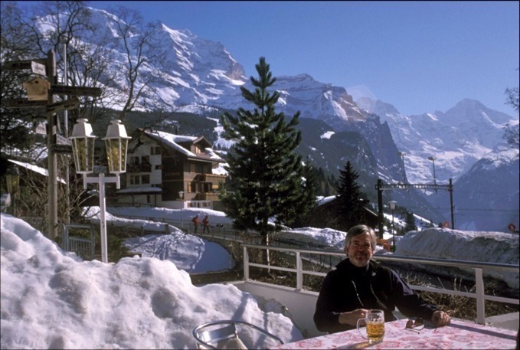
What I hear about smart growth
Wengen, Switzerland

Slide 7
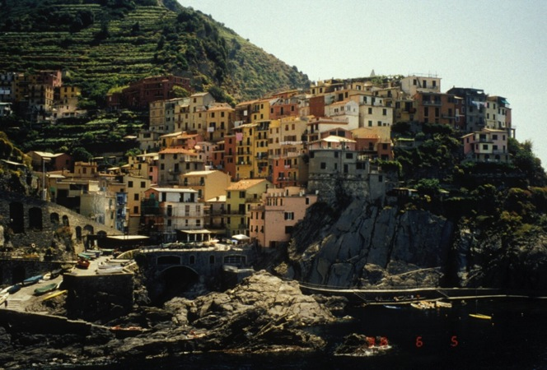
Smart growth is ugly.
Riomaggiore, Italy

Slide 8
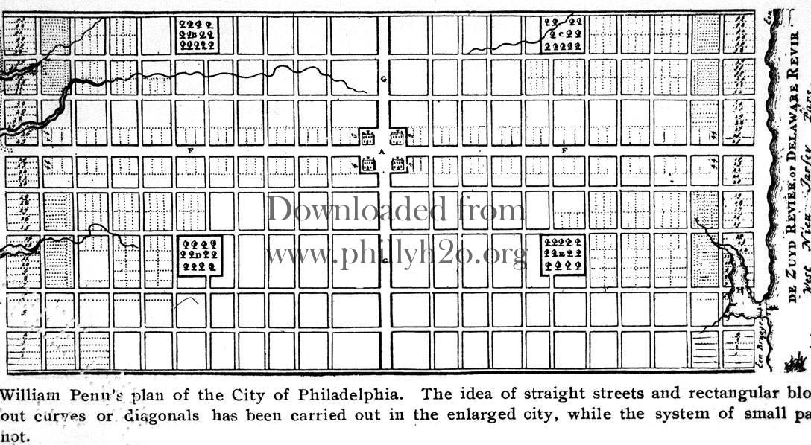
We have no history with it.
Philadelphia, PA

Slide 9
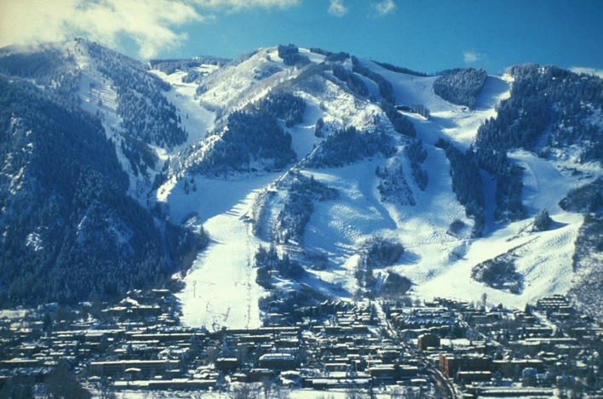
Nobody would want to live there.
Aspen, CO

Slide 10
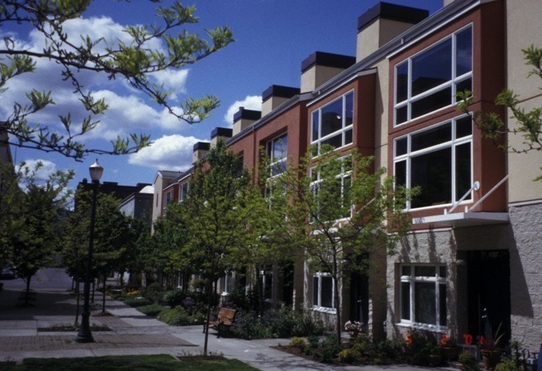
It just doesn’t work here.
Pearl District, Portland, OR

Slide 11
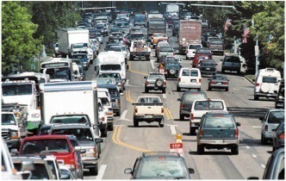
Shut up and drive!

Slide 12
“Trend is not destiny.”
-Lewis Mumford

Slide 13
The “silver tsunami”
Projections for 2010 through 2050 are from: Table 12. Projections of the Population by Age and Sex for the United States: 2010 to 2050 (NP2008-T12), Population Division, U.S. Census Bureau; Release Date: August 14, 2008

Slide 14
Demographic change and the labor force
THE CHANGING MARKET
Notes:
[Explain generational categories. Relationship of population to workforce.]
Millennials already outnumber Boomers, and are beginning to catch up to them in the workforce. As the latter retire, Millennials will soon dominate. “The U.S. Bureau of Labor Statistics predicts that by 2015 millennials will overtake the majority representation of the workforce and by 2030 this hyper-connected, tech savvy generation will make up 75% of the workforce.”
(from Wired, http://www.wired.com/insights/2013/08/the-rise-of-the-millennial-workforce/)

Slide 15
U.S. Housing Projections
Household | 1960 | 2000 | 2025
With children | 48% | 33 | 28
Without children | 52 | 67 | 72
Single | 13 | 26 | 28
U.S. as a whole | Supply 2003 | Change needed 2025
Attached | 27 million | 26 million more
Small Lot | 22 million | 30 million more
Large Lot (>7000 sq. ft.) | 57 million | 22 million less
Nelson, Arthur “Where Will Everybody Live?” EPA White Paper, Virginia Tech 2007

Slide 16
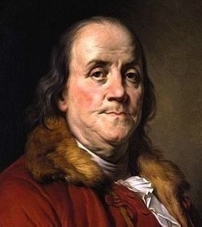
Why plan?
“By failing to prepare, you are preparing to fail.”
-Benjamin Franklin

Slide 17

Why plan?
“Have a plan. Follow the plan and you’ll be surprised how successful you can be. Most people don’t have a plan. That’s why it is easy to beat most folks.”
- Paul “Bear” Bryant

Slide 18
Leveraging BRT and TOD

Slide 19
What is BRT?
Bus Rapid Transit – “A flexible, rubber-tired rapid transit mode that combines stations, vehicles, services, running ways, and Intelligent Transportation Systems (ITS) elements into a permanently integrated system with a quality image and strong identity.
Notes:
Key to BRT is that, like LRT, it must be planned and implemented as an integrated package or system.
Every element should be considered individually in the respective physical and market context.
All should then be packaged together to yield a system that will produce more benefits as a whole than the sum of its parts.

Slide 20
What is TOD?
Transit-oriented development (TOD) – Compact, mixed-use development within walking distance of transit stations. TOD should:
Give people the choice to walk and bike and take transit
Boost transit ridership and minimize traffic
Provide a mix of housing, shopping and transportation choices
Generate revenue for the public and private sectors and provide value for new and existing residents
Create a sense of place

Slide 21
Planning for Economic and Fiscal Health
The pattern of development
– how we choose to grow –
affects a region’s ability to compete economically, to be fiscally sustainable, and to provide efficient and effective public services –
to maintain a high quality of life.
Notes:
Land use and transportation decisions have a big impact on many things – environment, health, public safety, quality of life –
AND, not least of all, economic and fiscal performance.
Land use policy is economic development policy. (Whether intentionally or not.)
(And, land use is a transportation strategy.)

Slide 22
The community is changing
THE CHANGING MARKET
Two major demographic changes are driving the market.
  The rise of the Millennials.
  The aging of the Baby Boomers.

Slide 23
Demographic change means preferences change.
And the market follows.
THE CHANGING MARKET
Notes:
With this shift in the demographic makeup of the country, preferences are changing, across the board.

Slide 24

THE CHANGING MARKET
Millennials
They follow lifestyle, not jobs.
Millennials choose where to live before finding a job.
Of all college-educated 25- to 34-year-olds 64% looked for a job after they chose the city where they wanted to live.
(U.S. Census)
Notes:
And they will move: “Young, well-educated adults are the most mobile Americans. Despite a decades-long, nationwide decline in moving by Americans, one million college educated 25 to 34 year olds move across state lines each year.” (Cortright, The Young & the Restless, Oct 2014)
Photo credit: “BJMAP touches down in Burlington, VT,” by Flickr user missmeng (Meng He). Retrieved at: http://www.flickr.com/photos/missmeng/5881124444. August 4, 2011. Creative Commons license.

Slide 25
Preferences: Transportation
THE CHANGING MARKET
Millennials are driving less
  From 2001 to 2009, the average annual number of vehicle-miles traveled by people ages 16-34 dropped 23 percent.
  (source: National Household Travel Survey)
  26 percent lacked a driver's license in 2010, up 5 percentage points from 2000
  (source: Federal Highway Administration)
Notes:
Cite: Michigan League of Cities quote:

Slide 26

Preferences: Transportation
THE CHANGING MARKET
Baby boomers turning in their keys
  Using local buses and trains more (source: National Household Travel Survey)
  Bike trips increased 64 percent between 2001 and 2009. (AARP)
Aside:
They’re not that interested in moving to “retirement communities.”
Average age entering senior housing used to be 70 – now it’s 86.

Slide 27
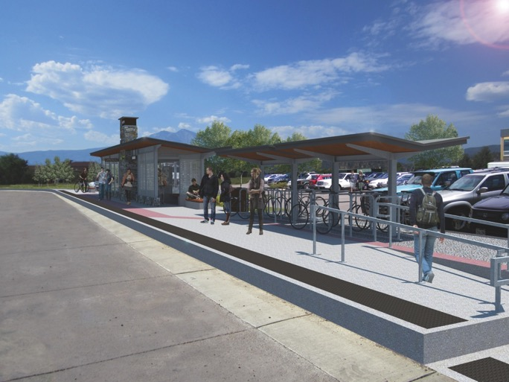
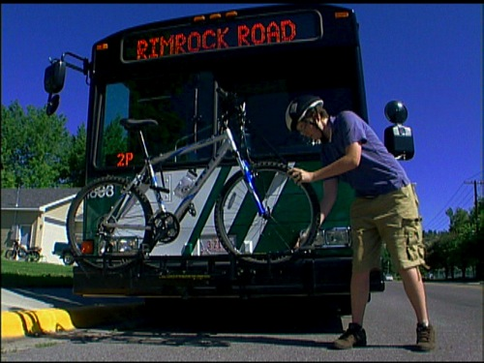
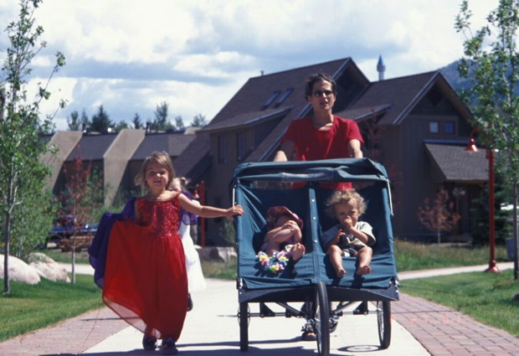
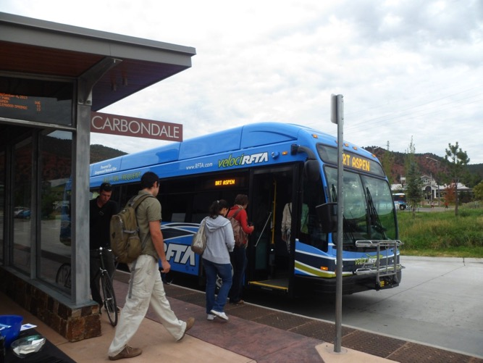
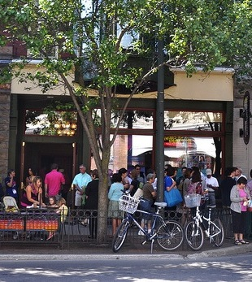
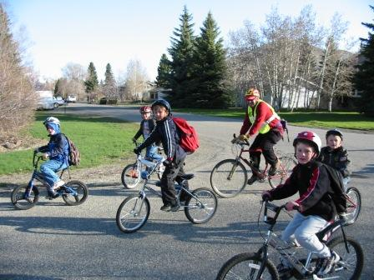
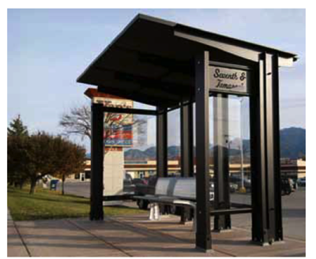
Preferences: Transportation choices
THE CHANGING MARKET

Slide 28
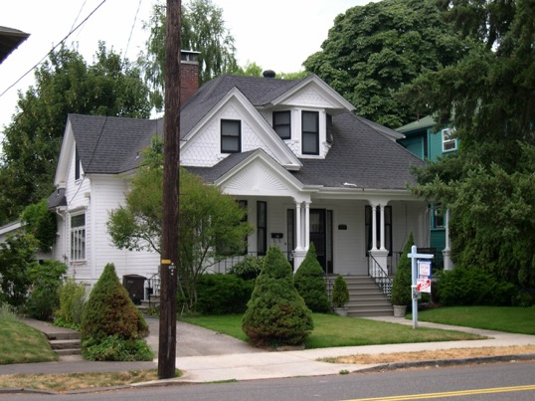
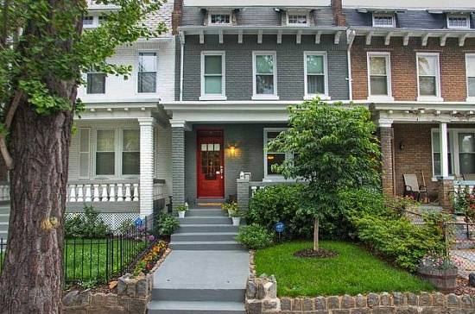
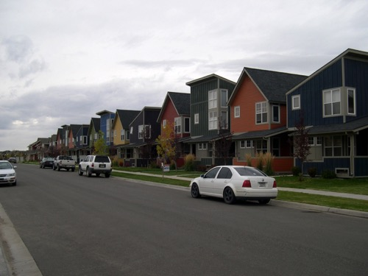
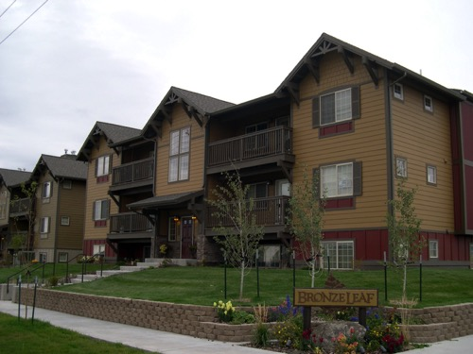
Preferences: Housing choices
THE CHANGING MARKET
Notes:
They also want more housing choices.

Slide 29
“Americans Prefer to Live in Mixed-Use, Walkable Communities”
THE CHANGING MARKET
-- National Association of Realtors
(October 2013):
78 percent say neighborhood is more important than the size of the house
Fifty-seven percent would forego a home with a larger yard if it meant a shorter commute to work
Source: Oct. 2013 Consumer survey conducted for the National Association of Realtors

Slide 30
“Americans Prefer to Live in Mixed-Use, Walkable Communities”
THE CHANGING MARKET
55 percent of respondents willing to forego a home with larger yard if it meant they could live within walking distance of schools, stores and restaurants as opposed to having larger yard and needing to drive to get to schools, stores and restaurants
Source: Oct. 2013 Consumer survey conducted for the National Association of Realtors

Slide 31
Preferences: Housing
THE CHANGING MARKET
Millennials especially are trending away from traditional suburbs
  47% would prefer to live in a city or a suburb with a mix of houses, shops, and businesses
  40% would prefer a rural community or a small town
  12% say they would prefer a suburban neighborhood with houses only

Slide 32
Preferences: Housing
THE CHANGING MARKET
Boomers are downsizing
  Increasing numbers, smaller households
  The number of senior households will grow twice as fast as all others over the next couple decades (A.C. Nelson)

Slide 33
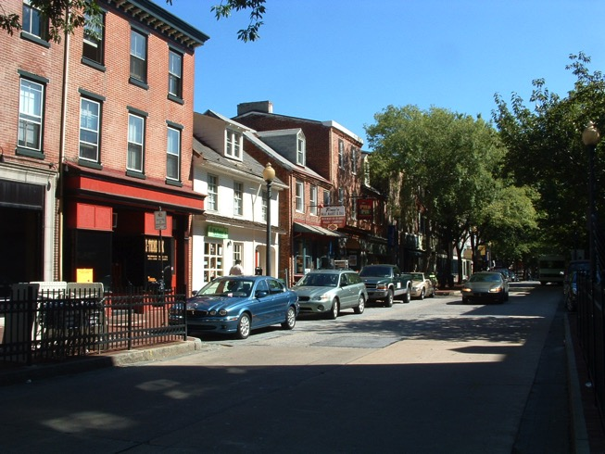
It’s not just big metropolitan areas, but small towns too
“The same demographic and market trends that are driving a return to big cities can also boost the prospects of smaller cities and towns surrounded by suburbs and countryside.”
-- Robert Steuteville, Small cities and towns are urban places, too - Better! Cities & Towns
The Other Walkable Urban Trend
Notes:
Data from Transit Center report, 2014 (see http://transitcenter.org/ourwork/mobility-attitudes-survey/)

Slide 34
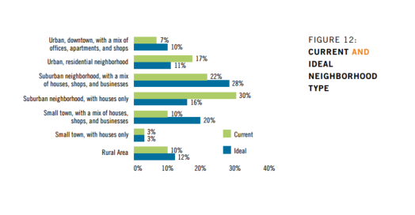

“About 10 percent of Americans would like to live in mixed-use small towns, but don't.” -- Robert Steuteville
Notes:
Data from Transit Center report, 2014 (see http://transitcenter.org/ourwork/mobility-attitudes-survey/)

Slide 35
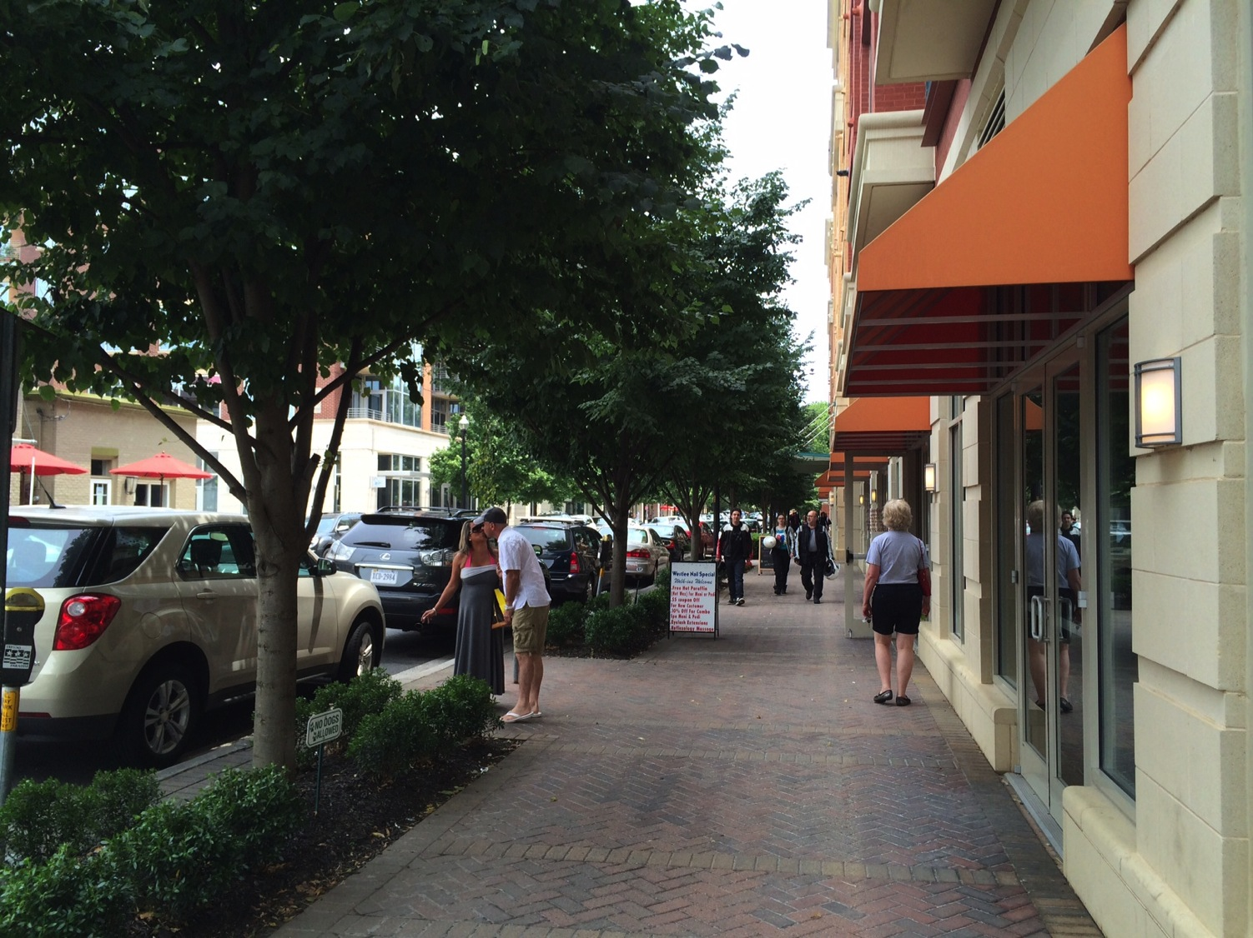
There is a price/value premium
for walkable places

Slide 36
There is a price/value premium
for walkable places

Slide 37
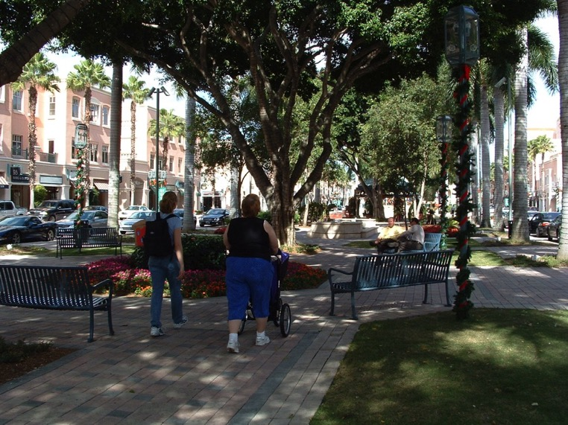
There is a price/value premium
for walkable places (residential)
Applies to residential real estate -
  Above-average walkability:
  → $4,000 to $34,000 more in home sales price
Sources: “Walking the Walk” by Joseph Cortwright, CEOs for Cities and
“The Walkability Premium in Commercial Real Estate Investments”
by Gary Pivo and Jeffrey Fisher
Notes:
“More than just a pleasant amenity, the walkability of cities translates directly into increases in home values. Homes located in more walkable neighborhoods—those with a mix of common daily shopping and social destinations within a short distance—command a price premium over otherwise similar homes in less walkable areas. Houses with the above-average levels of walkability command a premium of about $4,000 to $34,000 over houses with just average levels of walkability in the typical metropolitan areas studied.”
Joe Cortright,
“Walking the Walk: How Walkability
Raises Home Values in U.S. Cities,”
August 2009.

Slide 38
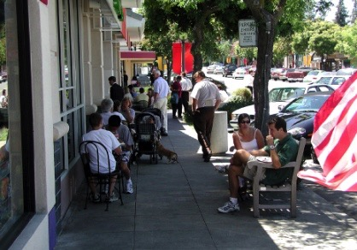
There is a price/value premium
for walkable places (commercial)
Applies to commercial real estate -
  Greater walkability:
  → 1% to 9% increase in commercial property value depending on type; also higher incomes and lower capitalization rates
Sources: “Walking the Walk” by Joseph Cortwright, CEOs for Cities and
“The Walkability Premium in Commercial Real Estate Investments”
by Gary Pivo and Jeffrey Fisher
Notes:
“We find that, all else being equal, the benefits of walkability are capitalized into office, retail and industrial property values with more walkable sites commanding higher property values. On a 100 point scale, a 10 point increase in walkability increases property values by 1 to 9 percent, depending on property type.”
Gary Pivo and Jeffrey D. Fisher,
“The Walkability Premium In Commercial Real Estate Investments,” February 2010.

Slide 39
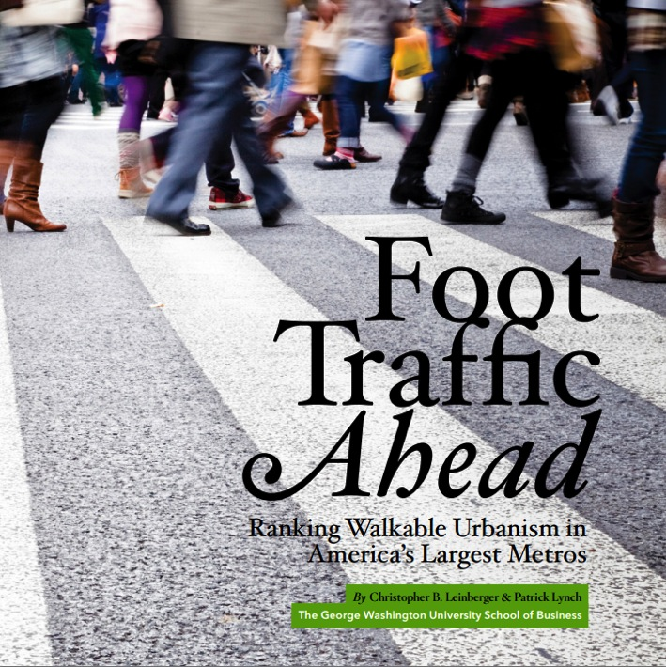
There is a price/value
premium for
walkable places
2014 study ranks the top 30 US metropolitan areas in walkability
Major findings:
The top ranking metros have an average of 38% higher GDP per capita as compared to the low ranking metros.
Office space in walkable urban places rents at a 74% higher premium per square foot over drivable sub-urban areas.

Slide 40
Communities are now in a ferocious competition over place
(whether they know it or not)

Slide 41
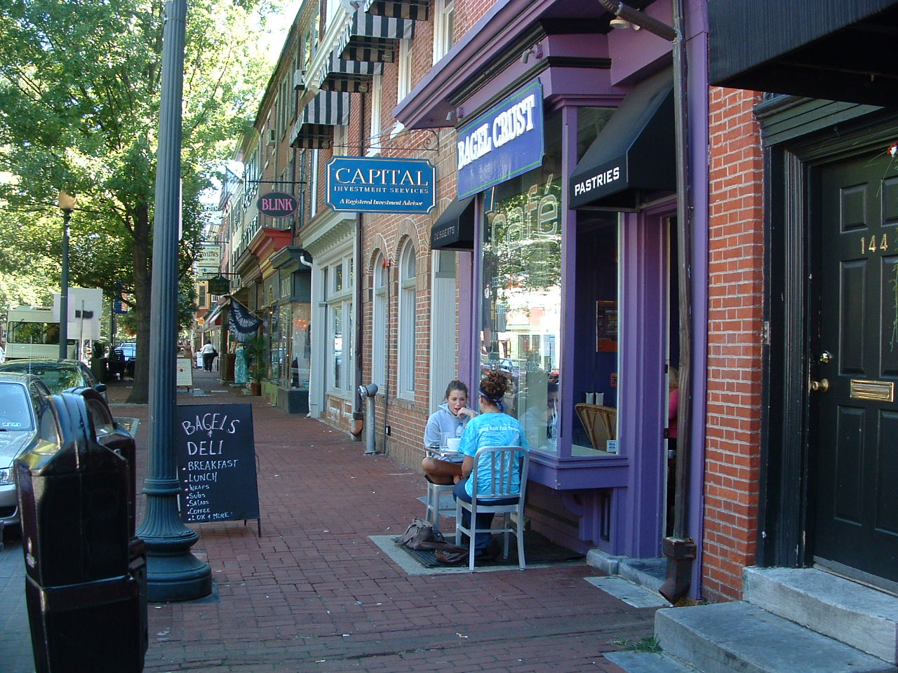
Smart growth is part of an
economic development strategy
Notes:
In this century, creating compact, walkable, mixed-use communities – that is, “smart growth” – is the key element for a successful economic development strategy.

Slide 42
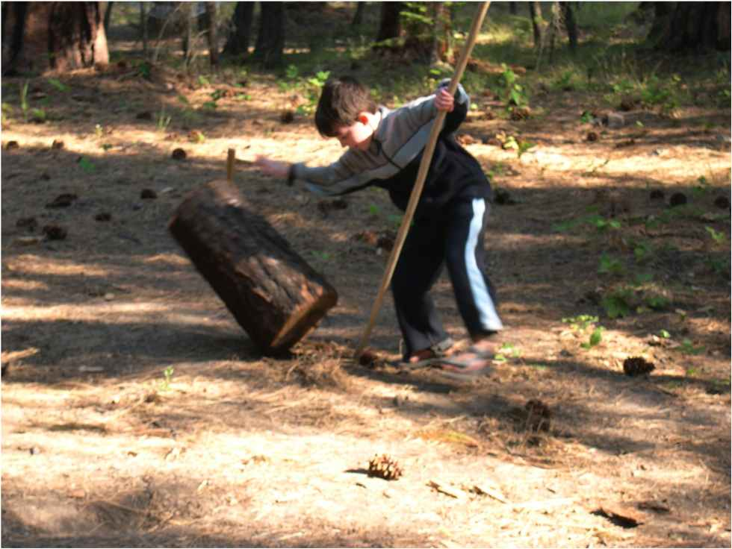
Tools for your toolbox

Slide 43
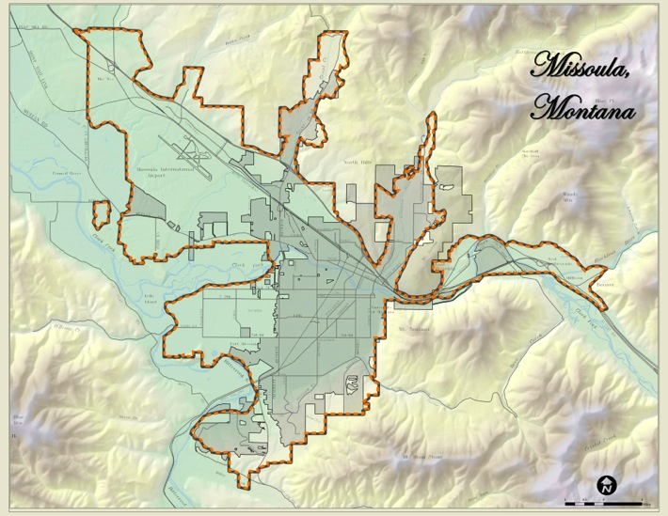


Growth allocation/scenario planning

Slide 44
Planning for about 15,000 new households over the next 20 years

Slide 45
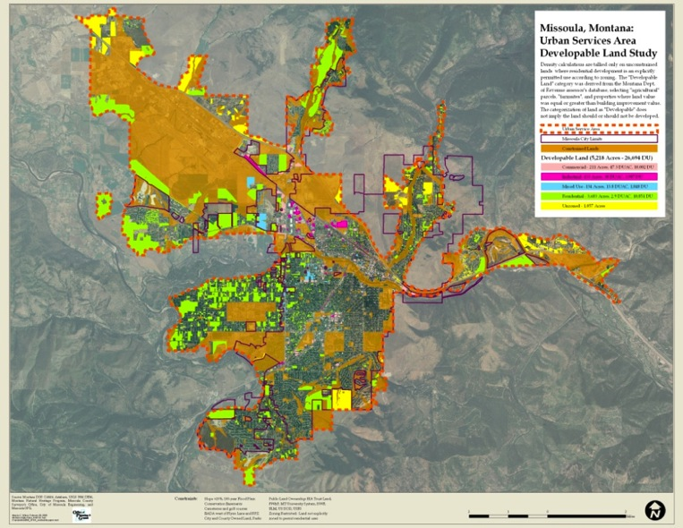
Supply of developable urban lands
Developable Land – 5,218 Acres
Zoned – 26,694 dwelling units
Unzoned – 3,641 dwelling units

Slide 46
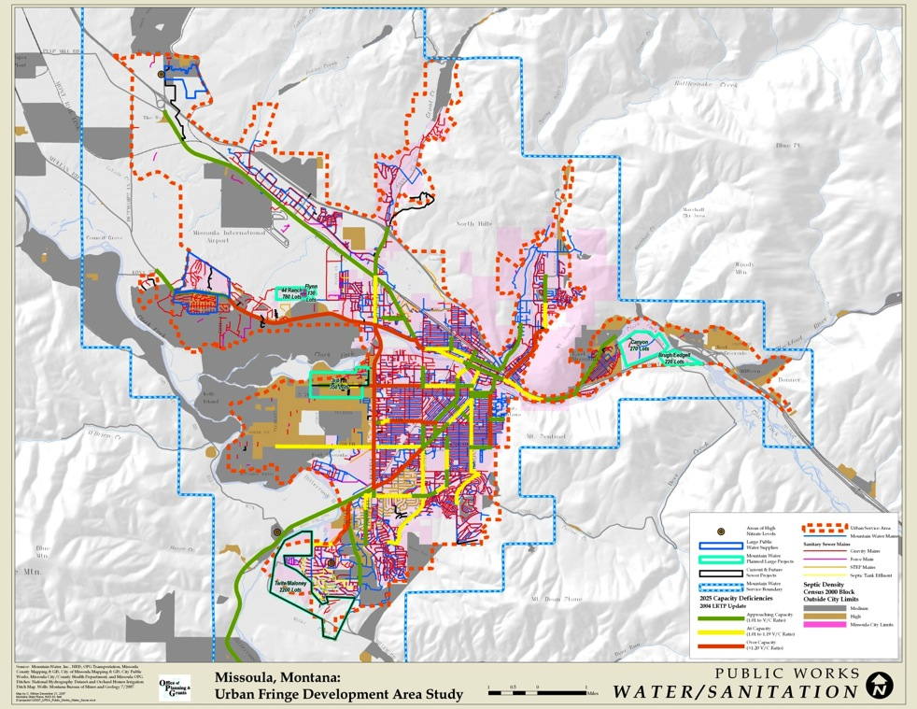
Infrastructure

Slide 47
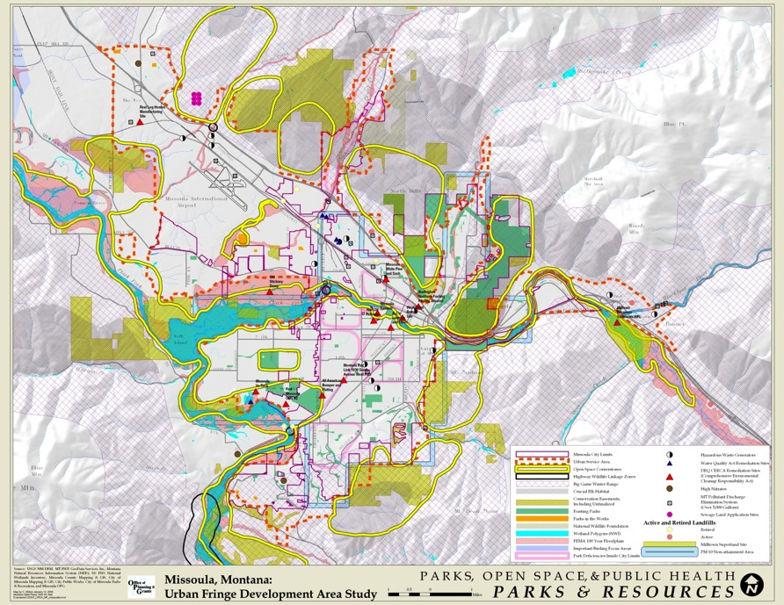
Parks, Open Spaces, and Public Health

Slide 48
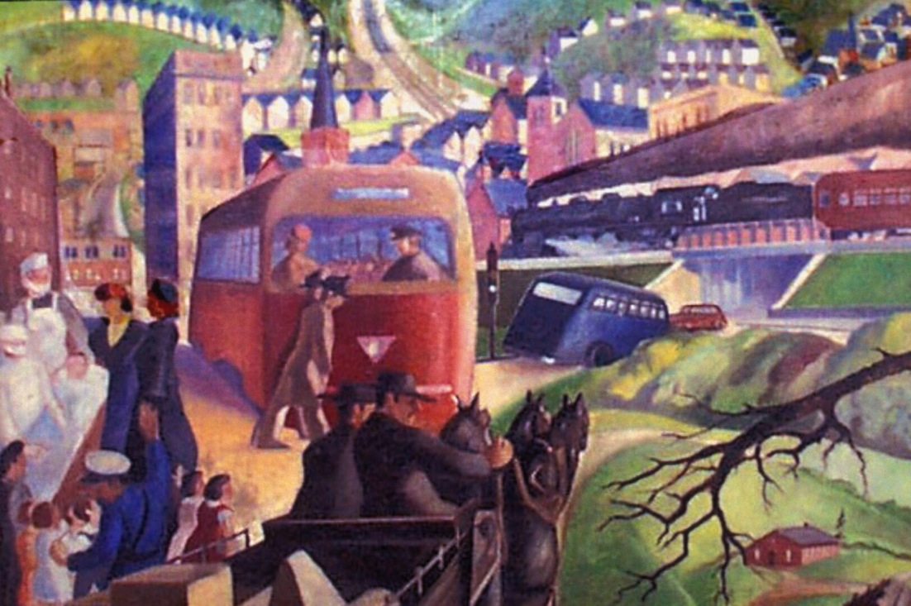
Scenario development
Wilkinsburg, PA

Slide 49
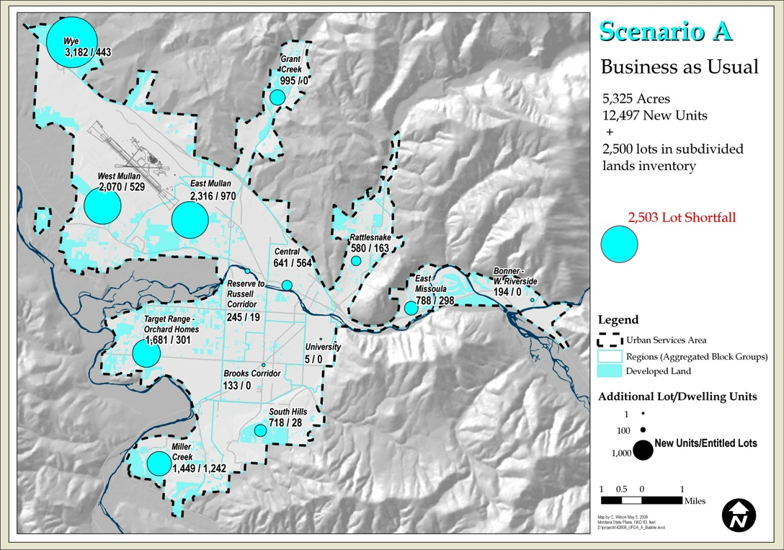
Scenario A

Slide 50
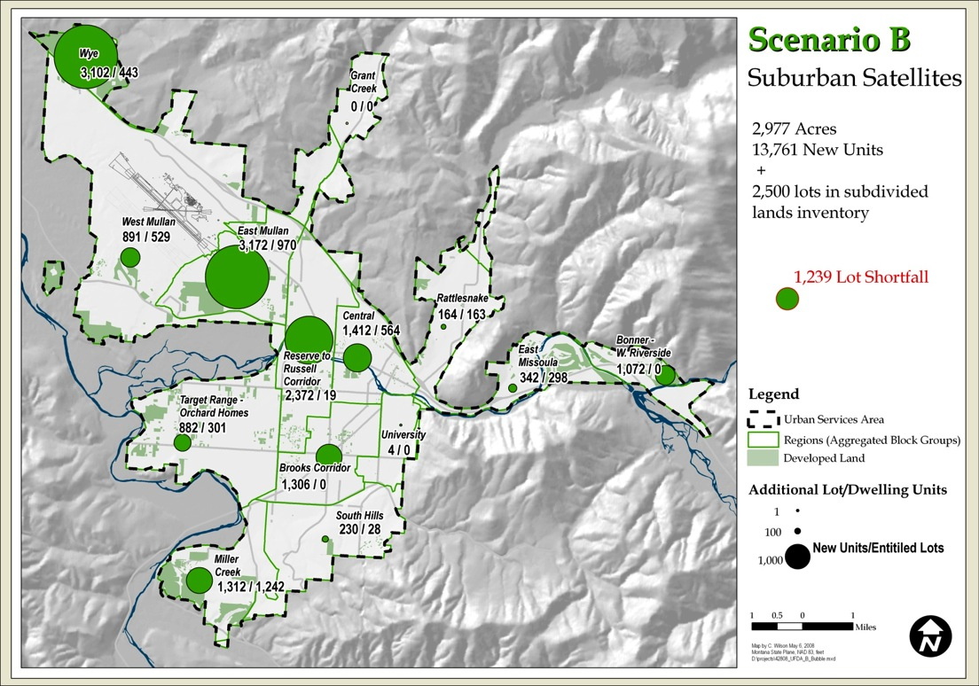
Scenario B

Slide 51
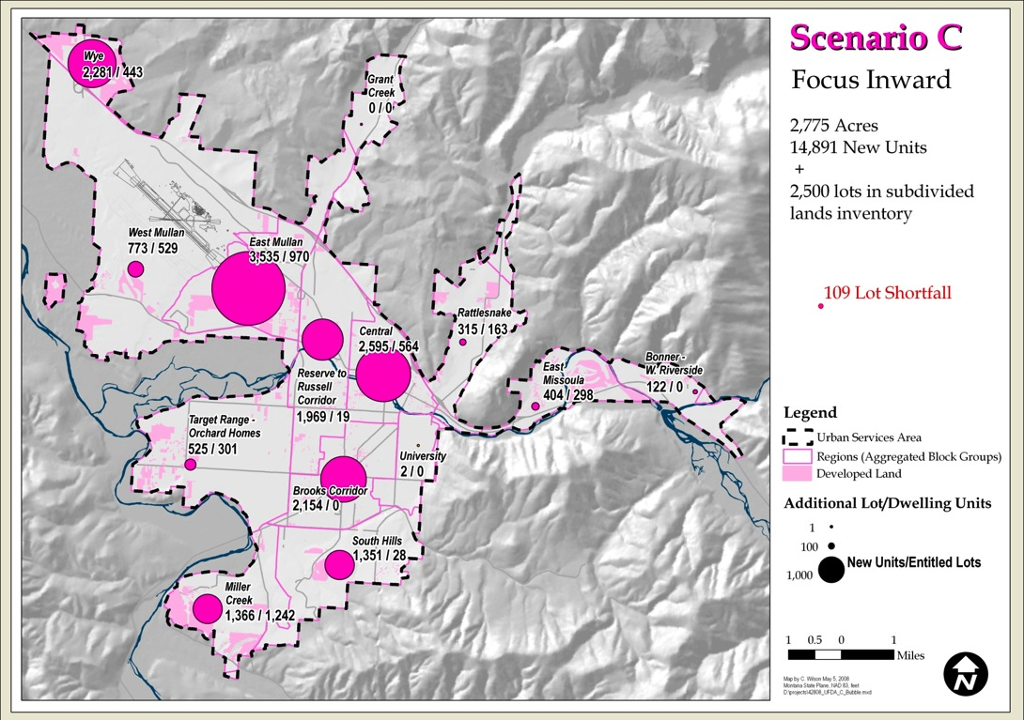
Scenario C

Slide 52
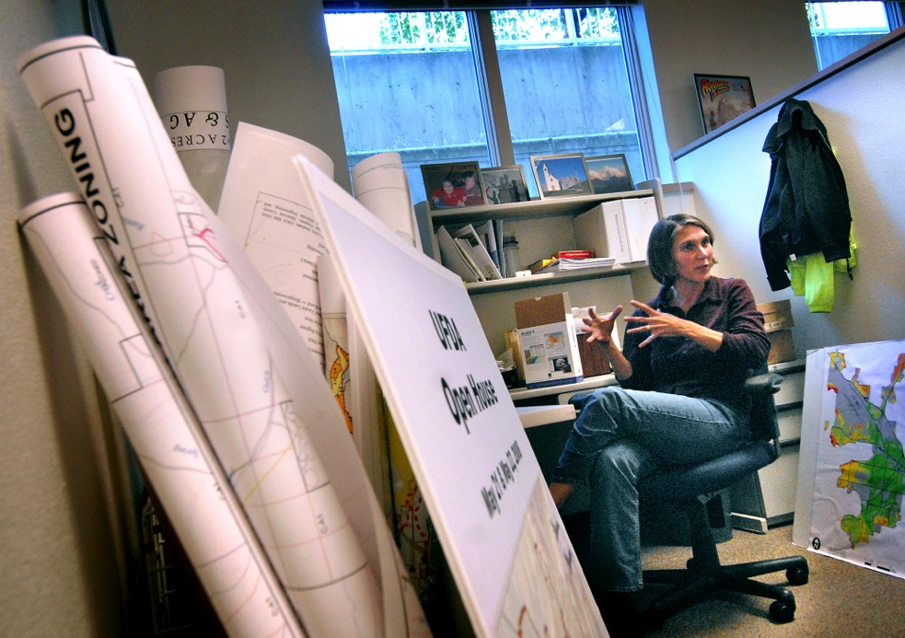
Suitability Analysis
Photo by Linda Thompson/Missoulian

Slide 53
Suitability Analysis
GIS tool to assess the lands inside the Urban Services Area as to their relative suitability for residential development.
Suitability can be defined in terms of:
  physical and cultural limitations of the land and public services
  community goals as expressed in the Growth Policy

Slide 54
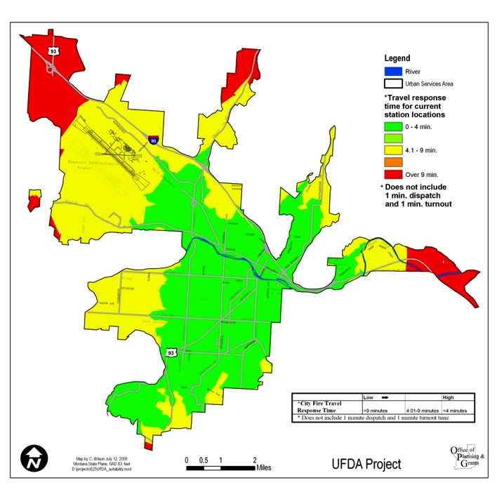
City Fire travel response time

Slide 55
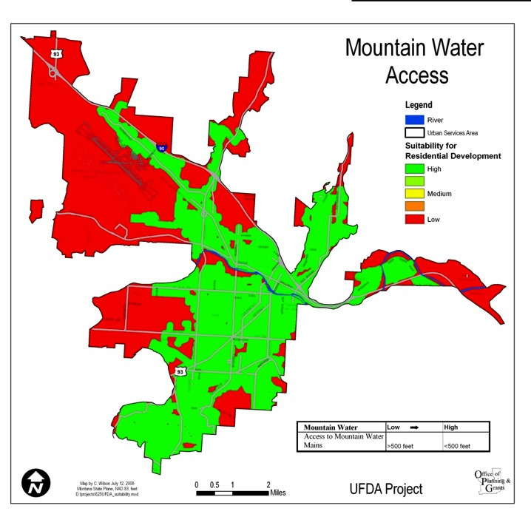
Access to Mountain Water lines

Slide 56
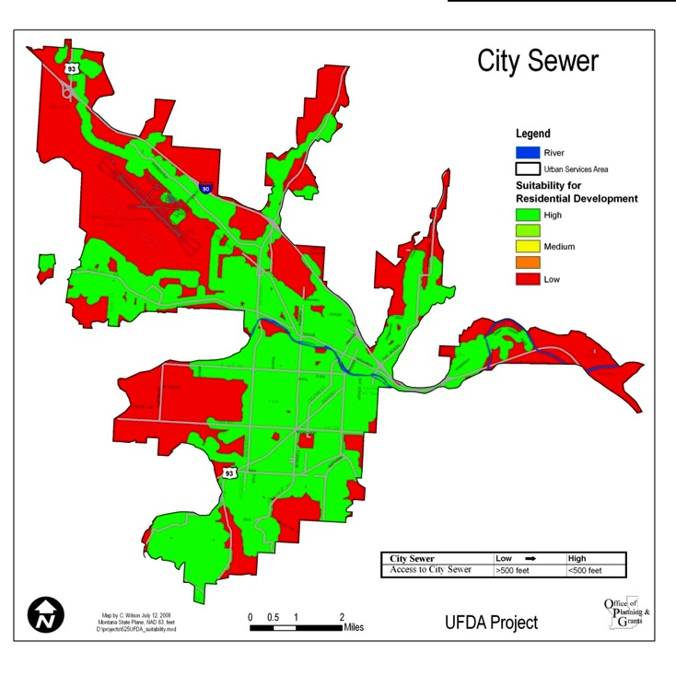
Access to City sewer

Slide 57
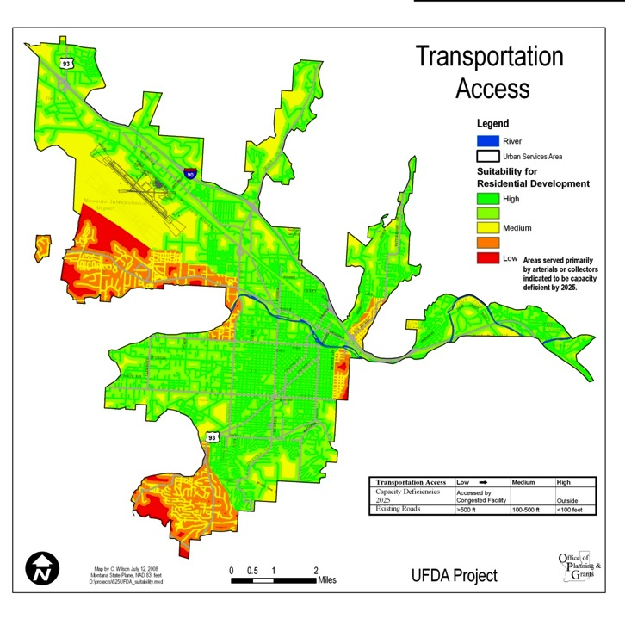
Access to roads

Slide 58
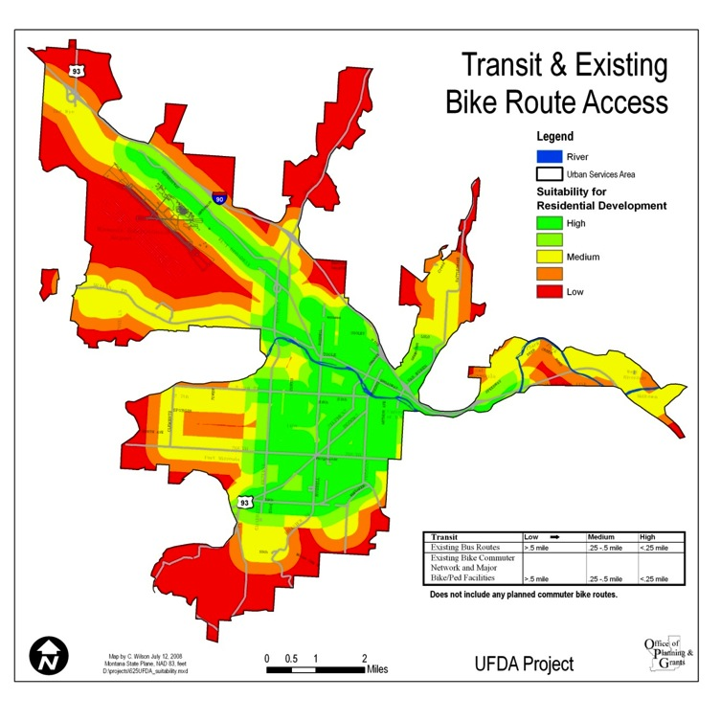
Access to transit and bike routes

Slide 59
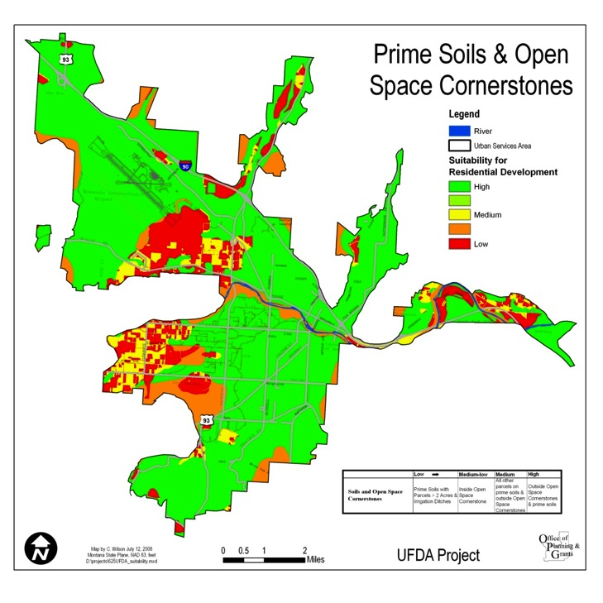
Prime soils and open space cornerstones

Slide 60
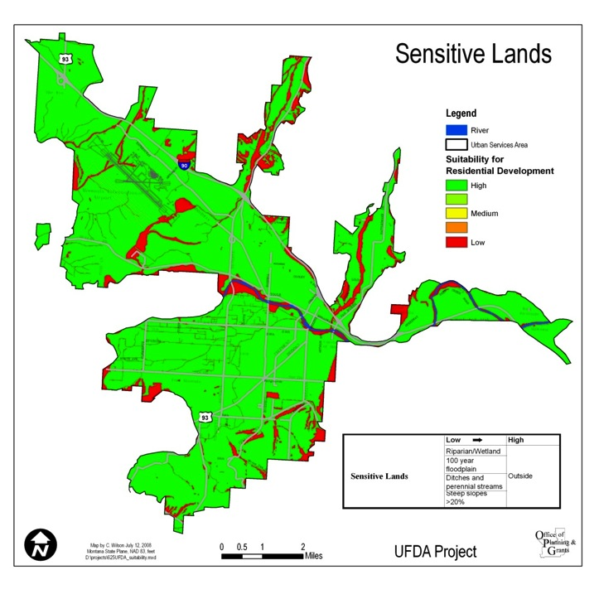
Sensitive lands

Slide 61

Key wildlife habitat

Slide 62
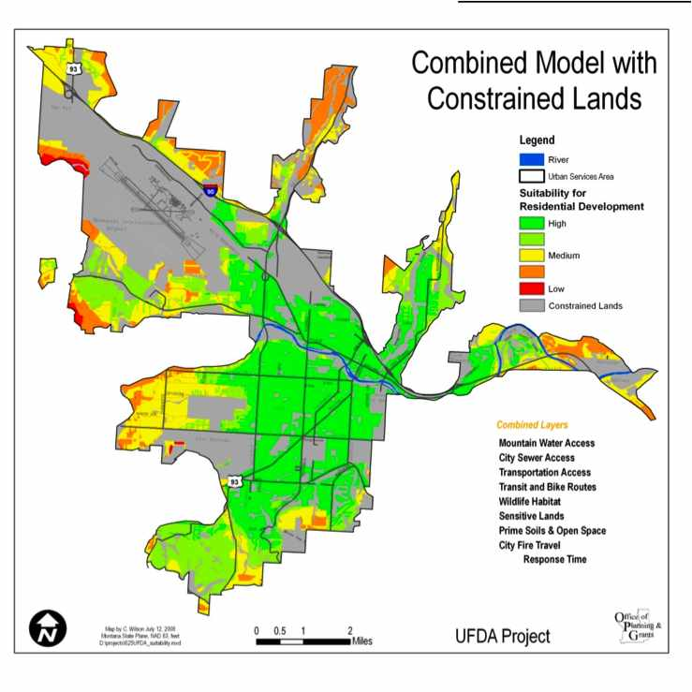
Combined model with constrained land

Slide 63
Residential Allocation Map
Annexation and zoning decision
Infrastructure investment
Neighborhood planning

Slide 64
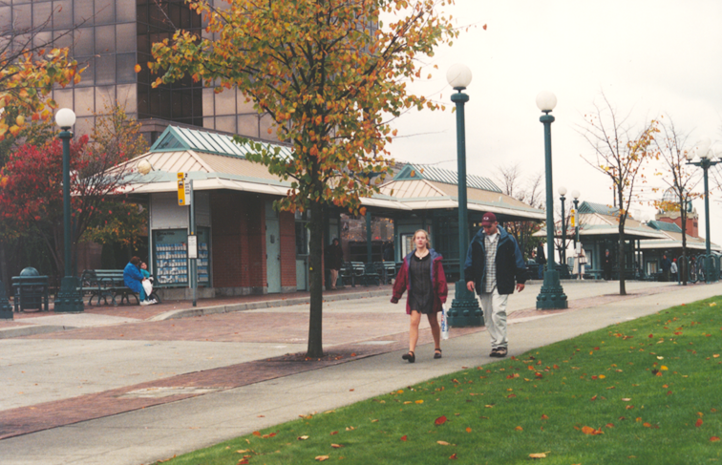
Pedestrian Overlay Districts
and Design Guidelines

Slide 65
Pedestrian Overlay District
Pedestrian Overlay Districts and Design Guidelines
Review existing land uses, transit
and pedestrian generators, and linkage opportunities
Develop design tools to encourage pedestrian travel and access to transit

Slide 66
Comprehensive Plan
Zoning Code
Pedestrian
Overlay District
Pedestrian Overlay Districts and Design Guidelines
Design
Guidelines

Slide 67
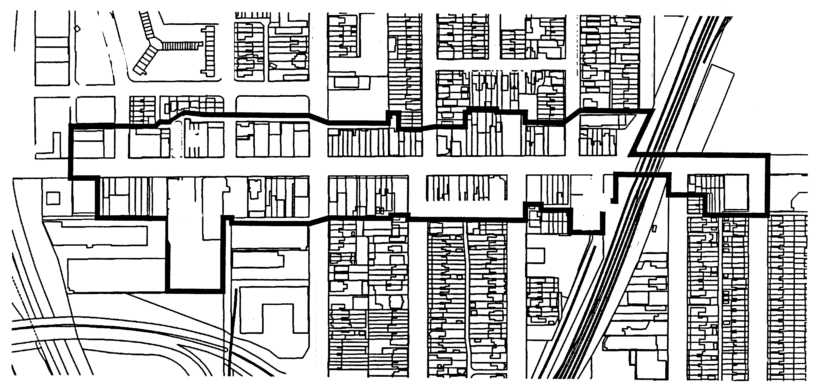
Pedestrian Overlay Districts and Design Guidelines

Slide 68
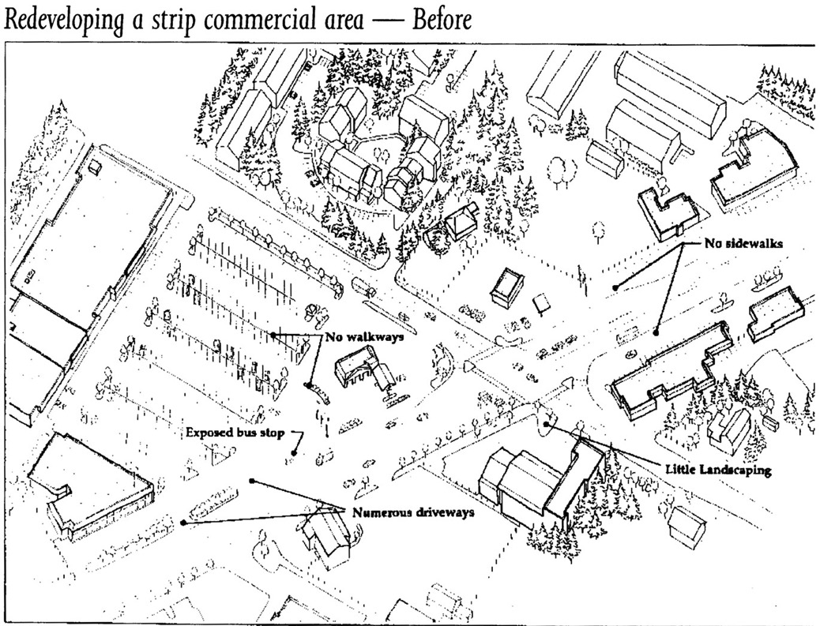
Pedestrian Overlay Districts and Design Guidelines
Source: Redevelopment for Livable Communities, Washington State Energy Office, 1996

Slide 69
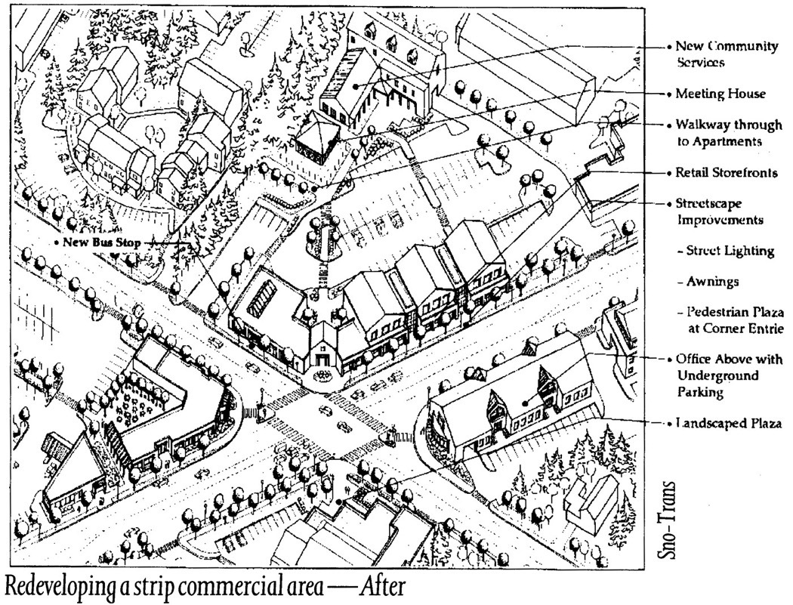
Pedestrian Overlay Districts and Design Guidelines
Source: Redevelopment for Livable Communities, Washington State Energy Office, 1996

Slide 70
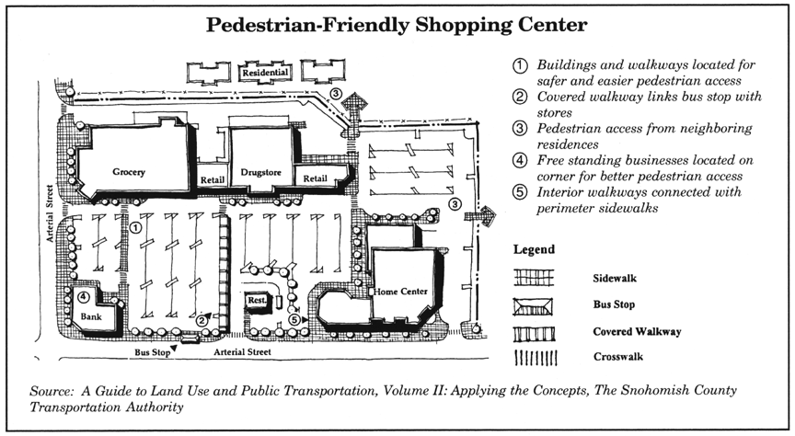
Pedestrian Overlay Districts and Design Guidelines

Slide 71
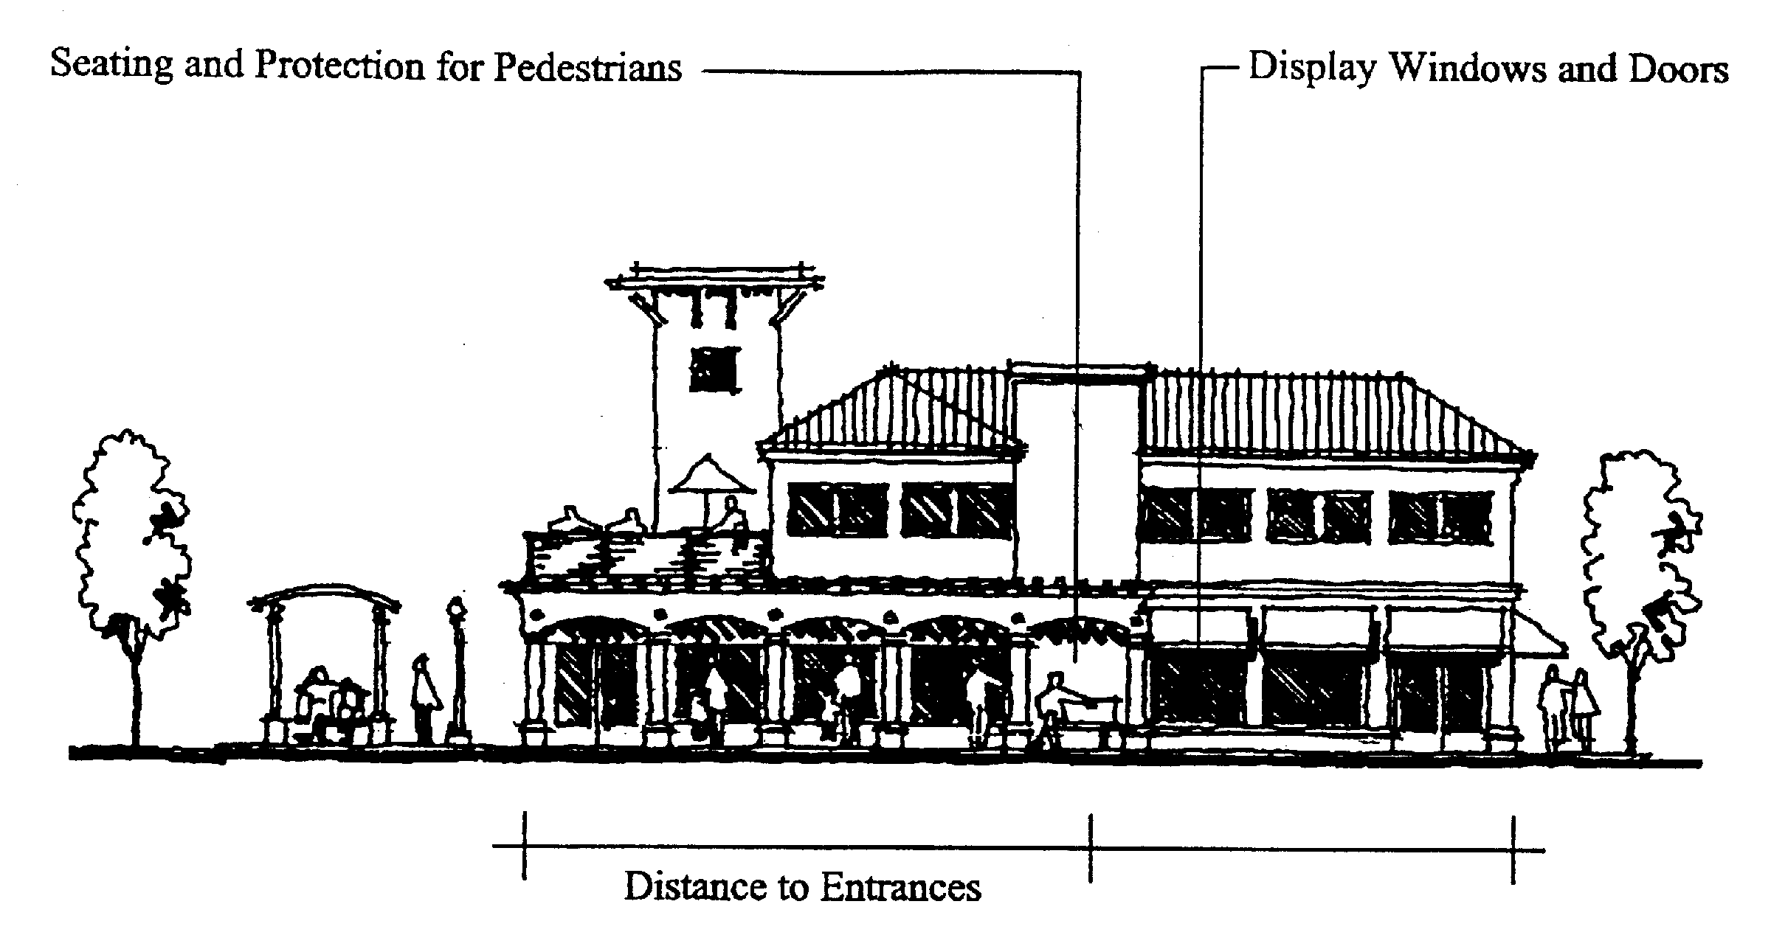
Pedestrian Overlay Districts and Design Guidelines

Slide 72
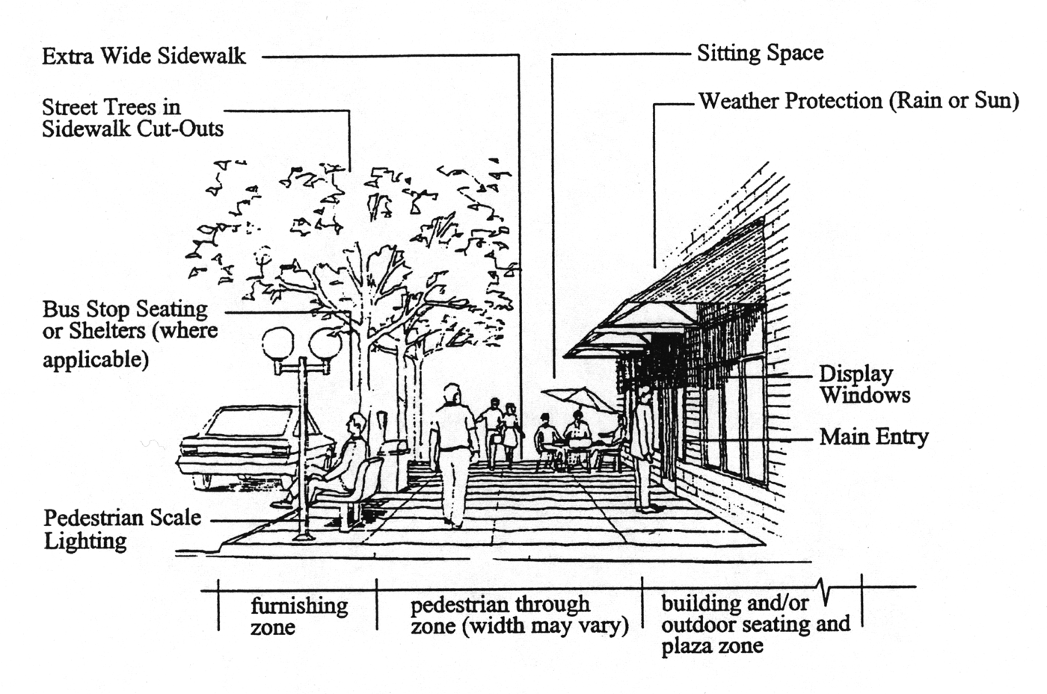
Pedestrian Overlay Districts and Design Guidelines

Slide 73

Pedestrian Overlay Districts and Design Guidelines
Photo Credit: Project for Public Spaces, Inc.;
source: The Role of Transit in Creating Livable Metropolitan Communities, 1997

Slide 74
Form-Based Code
Focus primarily on regulating urban form and less on land use
Regulatory rather than advisory
Emphasizes standards and parameters for form with predictable physical outcomes
  build-to lines
  frontage type requirements
Requires private buildings to shape public space through the use of building form standards with specific requirements for building placement
Promotes and/or conserves an interconnected street network and pedestrian-scaled blocks
Keyed to specific locations on a regulating plan
Diagrams in the code unambiguous, clearly labeled, and accurate in their presentation of spatial configurations

Slide 75
Form-Based Code

Slide 76

Form-Based Code

Slide 77

Form-Based Code

Slide 78
Five Tests of Community*
Popsicle Test – Can you walk home from the store before your popsicle melts?
Smooch Test – Is the place comfortable, safe, attractive, and intimate, suitable for a date-night stroll?
Kid Test – Can children safely explore a world beyond their own backyards?
Seniors Test – Are elder citizens a welcome part of the community? Can they get out and about and get their needs met when driving is no longer an option?
Commons Test – Does development contribute to the overall community something greater than what it takes in terms of natural and community resources?
*from Choosing Our Community’s Future, A Citizens Guide to Getting the Most Out of Development, Smart Growth America, 2005

Slide 79

Thank you!
rmillar@smartgrowthamerica.org
www.smartgrowthamerica.org

